Slide 1

BOM Workflow Instructions

Slide 2
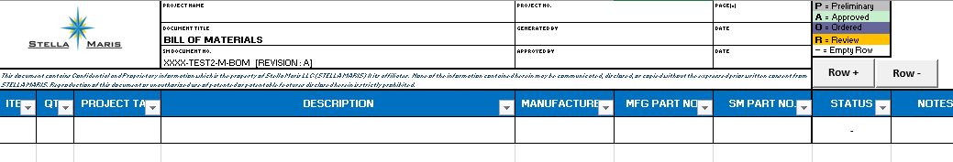
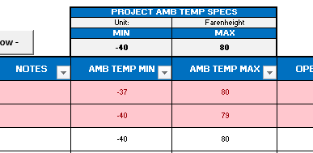
BOM Additions :
The body (data) of the BOM is formatted as a table.
On Save – Workbook will automatically export the BOM data in a .csv file and save to a network folder. You will not see any change in the BOM workbook that you are using.
In title block, the file name value for SM. Document No. is automatically imported from Vault. The structure of how the file is named is driven by a pre-configured number scheme in Vault. Upon opening the workbook, the file name will appear in the title block. In addition, the Revision Number / Letter will also appear next to the file name. **Known issue: Vault Server can take a few seconds to send and update the information on the BOM. See “Known Issues” for further information**
buttons have been added to keep the user from entering data outside of the table, and to keep row and column data formatting consistent and uniform. Select anywhere within the table then select Row + or Row – to make changes. You can even select the row below the table and click Row + to add a new row.
Filters are enabled by default.
Project Ambient Temp Specs feature added. Enter the Project Spec MIN and MAX, then as you move down and enter AMB TEMP MIN / MAX data, your row will highlight red if the product specs do not meet the project specs. The rules for highlighting red are: Product MIN > Project MIN and Product MAX < Project MAX

Slide 3
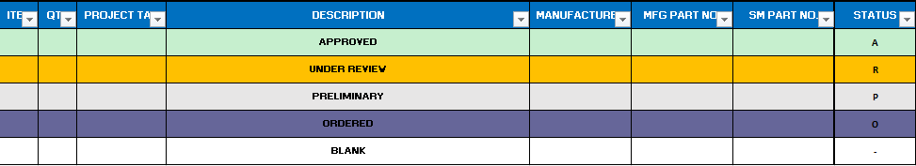

BOM Additions continued:
By default when the user presses the inserted row is set to “P” (Preliminary).
Rows are automatically highlighted based on the Engineer / Project Manager assigned status.
Should the user need to add a separation between data for example, a subtitle such as “Fitting Take Off”, the user must select “-” in the status column indicating a blank row. This is necessary to be able to parse through the .csv file and extract data from the BOM to be used elsewhere.
The user can format (resize, change color, etc.) columns. Should a customer not need to see for example, the “SM PART NO.” column, it is recommended to leave the column blank. As an alternative, change the font color of “SM PART NO. to match the blue background. **Known Issue**
Print Orientation is set to “Landscape” and Print Area is set to include the Title Block as well as columns (ITEM : SM PART NO.) by default
The user can format the row height.

Slide 4

BOM Restrictions : Green = Ok to Edit Dark / Orange = Protected
The user cannot:
Change the Title Block titles ex: “Project Name” in title block. OK to edit values underneath. Do not edit value under “SM DOCUMENT NO.” It must remained unlocked to receive information from VAULT.
Change column names, delete columns, change column data type. OK to change color and resize.
Adding / Deleting Rows without using buttons at top right. You must select a cell within the table then press Row + or Row - to insert or delete a row. You can also select a range of cells to insert or delete.
Add new worksheets to Workbook, nor rename worksheet tab
Add data to any place other than title block and BOM table body (data)
Protect the workbook. It is protected by default now. Any structural changes, column name changes, additions or deletions will need password. I will have password and Ryan Leblanc will have password.
When finished with BOM for the workday, just press Save (NOT SAVE AS) and Check the File back into Vault.
Vault will recognize files not generated using this system.

Slide 5
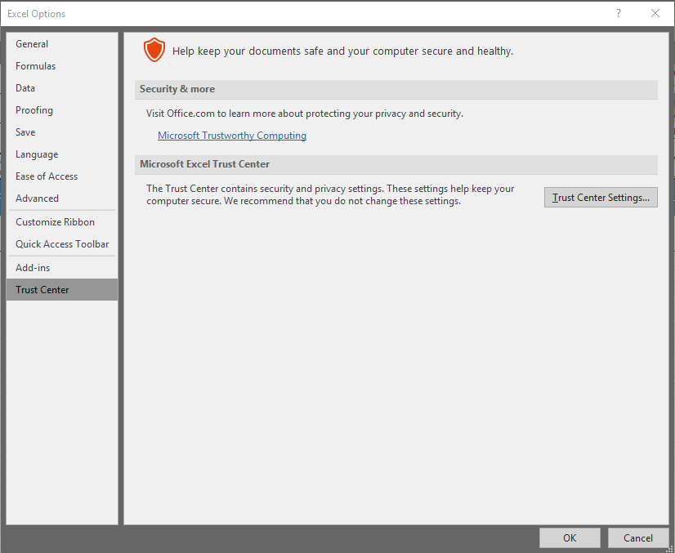
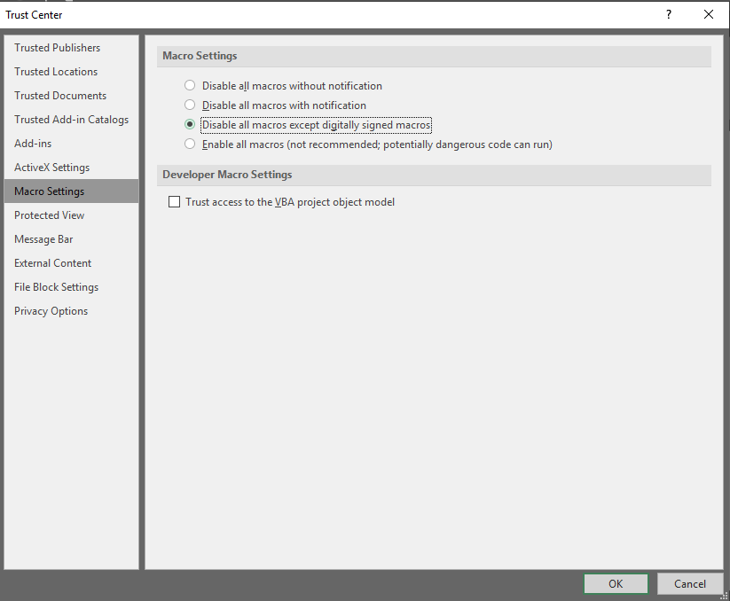
EXCEL initial setup for BOM Set Trust Center settings for Excel Macro Workbook
Note:
You may still need to select “Enable Macros” underneath the formula bar on initial workbook open. After you’ve selected this, Excel should remember your preference upon adding the “Trusted Location”
Open a blank Excel workbook
Go to File -> Options
Go to Trust Center
Click “Trust Center Settings”
In Trust Center Settings window select “Macro Settings” from left column
Click “Disable all macros except digitally signed macros”
In same Trust Center Settings window select “Trusted Locations” from left column
Select “Add Location”
Browse for “C:\Work” (This is your Vault Working Folder, if it is not set to this already please let me know)
Select “Subfolders of this location are also trusted”
Save Settings and Exit

Slide 6
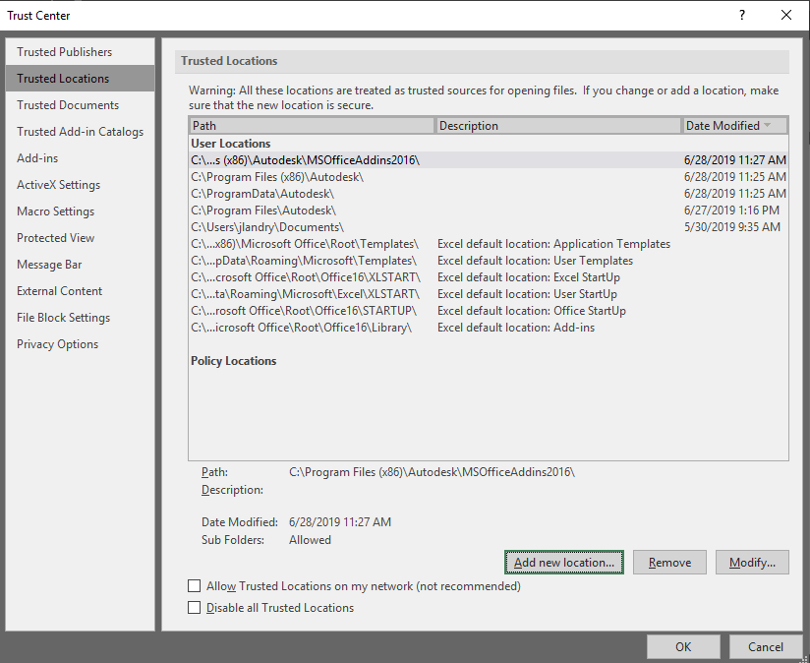
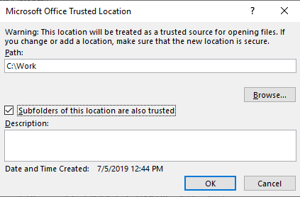
Set Trust Center settings for Excel Macro Workbook (continued)
Excel

Slide 7

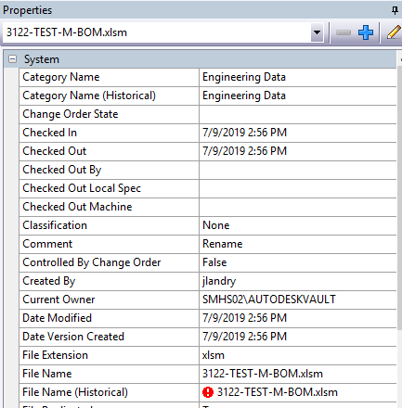
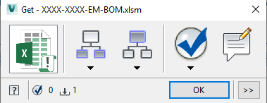
IMPORTANT!!!
VAULT SETTINGS
BEFORE ANY AND ALL CHECKOUTS
Make sure that that the Property Compliance Column does not show
If it does, you can see Non-Compliance properties in the Property window on right hand side of screen.
NOTE:
This should occur only on:
Initial BOM creation workflow
Changing of state from “Work in Progress” to “Released” and vice versa.
Reasons for occurrence:
File Name Changed
Category Changed
State Changed
Revision Changed
Solution:
SELECT GET (Screen below will show)
THEN CLICK OK
SELECT
THEN
& CLICK OK
Confirm Sync and CLICK CLOSE

Slide 8
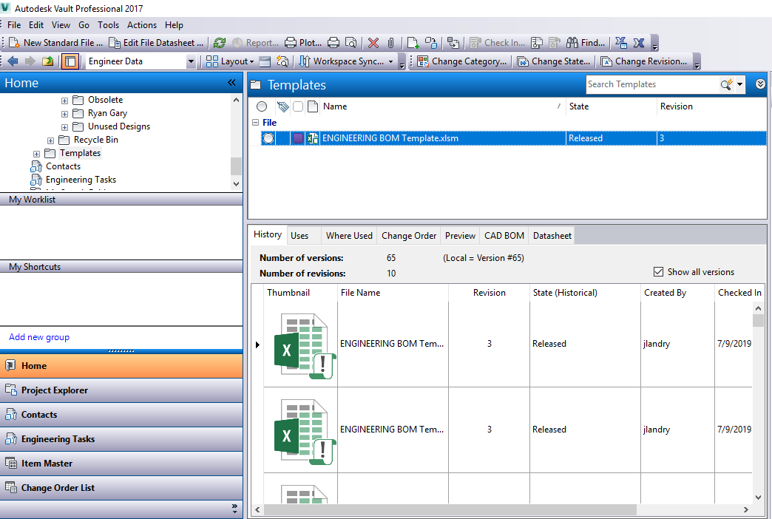
To see Vault properties relevant to BOM, you will need a custom view similar to the following :
Vault

Slide 9
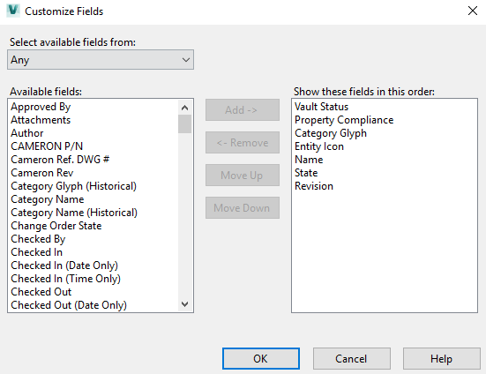
To see properties relevant to BOM, modify your custom View Settings in Vault to include the following as a minimum:
Vault

Slide 10
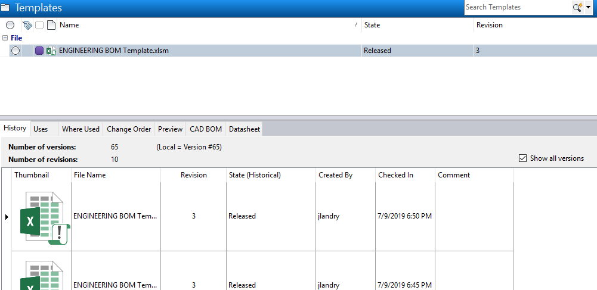
Vault
Properties continued
Right Click here, then select “Customize views” to add these properties.

Slide 11



Vault BOM Creation Workflow
Job Folder Created?
BOM Folder Created?
Navigation Pane
Main Vault Window
Navigation Pane
Main Vault Window
Yes
Yes
> Project Explorer
> Designs
> Templates
CTRL+C (Copy)
> Project Explorer
> Designs
> Job Number
> BOM Folder
CTRL+V (Paste)
No
No
Rename Wizard
Rename Wizard
Navigation Pane
RIGHT CLICK
& SELECT RENAME
SELECT
& CLICK NEXT
SELECT
> Project Explorer
> Designs
> Job Number
Navigation Pane OR Main Vault Window
Generate File Number
Generate File Number
Create Job Folder
CLICK WITHIN
Enter File Number As:
SM JOB NO. - UNIT SUFFIX - DEPT - BOM
Ex: 3120-HPU-E-BOM
E – Electrical
M – Mechanical
EM – Electrical & Mechanical
Rename Wizard
CLICK OK, FINISH
& CLOSE Rename Wizard
Navigation Pane OR Main Vault Window
Create BOM Folder
Vault Toolbar
CLICK
Main Vault Window
Confirm Category is: Engineering Data
Confirm State is: Work In Progress
Confirm Revision is: A
Confirm file looks like:
THEN to CHECK OUT,
DBL CLICK on your BOM file & CLICK YES to CHECK OUT
Confirm Sync
Vault Toolbar / Get Window
Vault Toolbar
SELECT GET (Screen below will show)
THEN CLICK OK
Vault Toolbar
SELECT
THEN
& CLICK OK
Confirm Sync and CLICK CLOSE
Vault Toolbar
SELECT
& CLICK OK

